Slide 1

Steam Reviewer Analysis
Terence Pak
12/06/2020

Slide 2
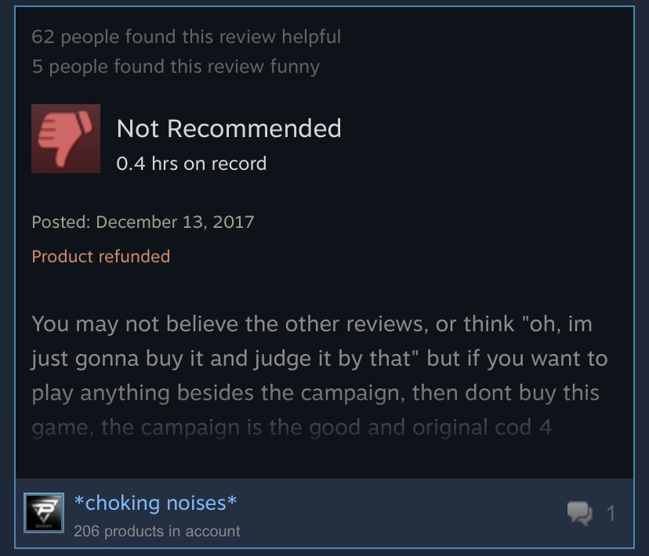
Analysis Background
The Steam platform is the largest digital distribution platform for PC gaming. Approximately 50 -70% of the world’s PC game downloads take place on Steam. (I)
The analysis is based on steam user reviews. Steam players leave reviews for games and can highlight key aspects on why they recommend or don’t recommend the game to others. Reviews are important, because they can drive potential players to actually purchase the games.
Datasets include:
Steam reviews
Game Description

Slide 3
Data Assumptions
Steam Player ages are 13+ years old.
Every person who posted a review has purchased the game.
Every person who posted a review meets minimum graphics requirements.
Not every person who posted a review has played the game fully.
Steam games that have more than 20+ reviews are included for regression analysis.
These reviews are posted as of Feb 16, 2019.

Slide 4
Objectives
What are the most popular games on Steam and Why? What can Steam do to enhance the reviewer’s experience?
Key words for popular games
What attributes of games should Steam be interested in analyzing?
Genres
Original Cost
Metacritic Scores
Median number of hours played
Gameplay Types

Slide 5
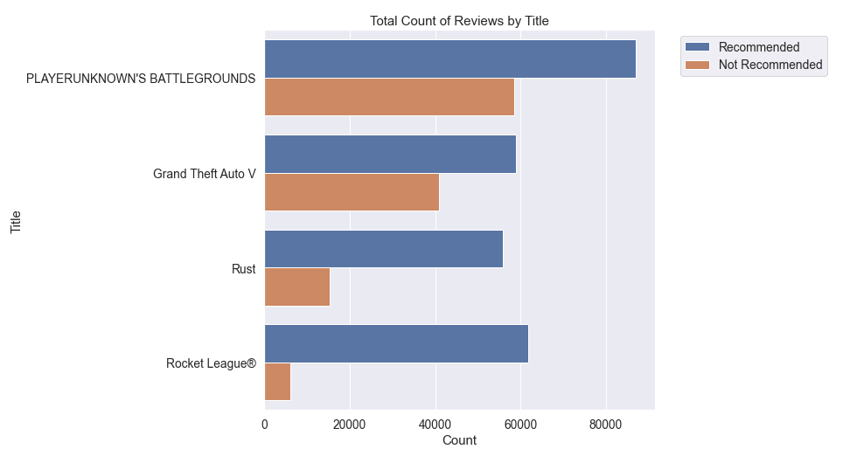
Most Popular games
Listed are the top 4 most reviewed games on Steam.
What these games have in common is online multiplayer functionality, and shows that Steam reviewers are very interested in this Genre.

Slide 6
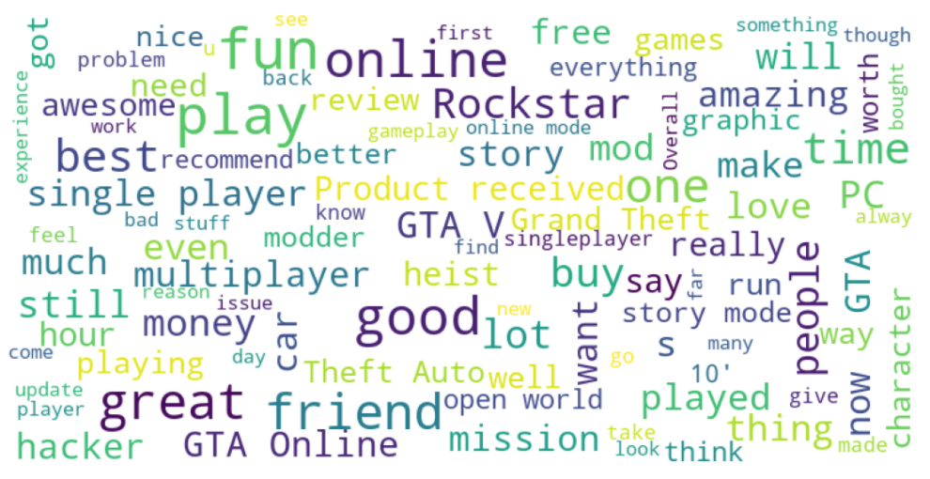
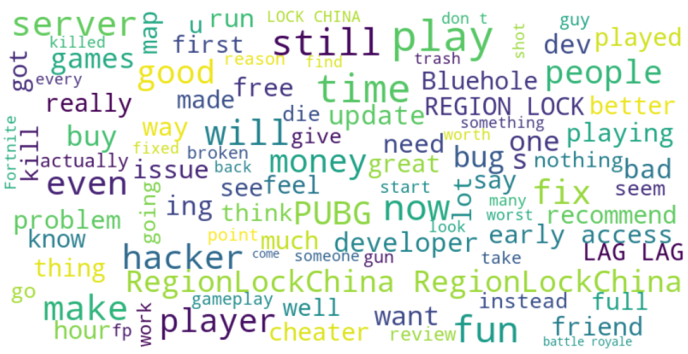
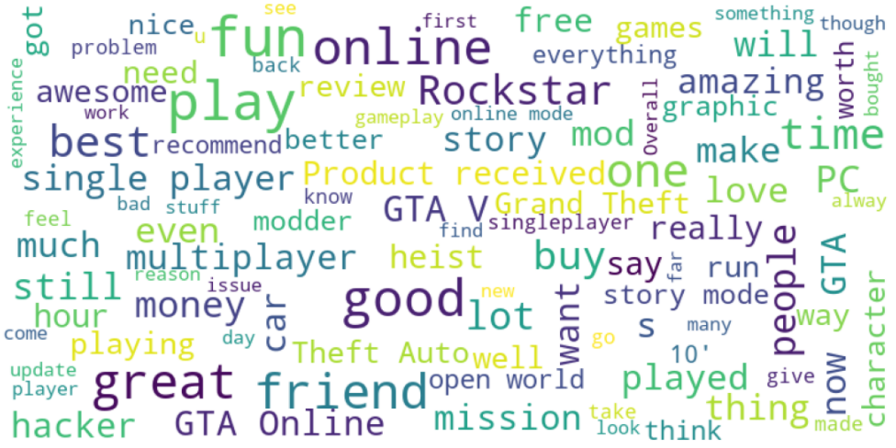
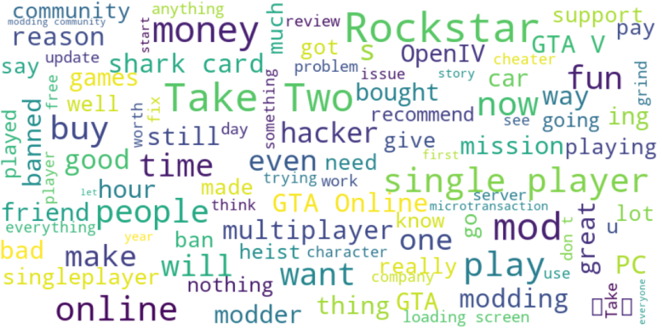
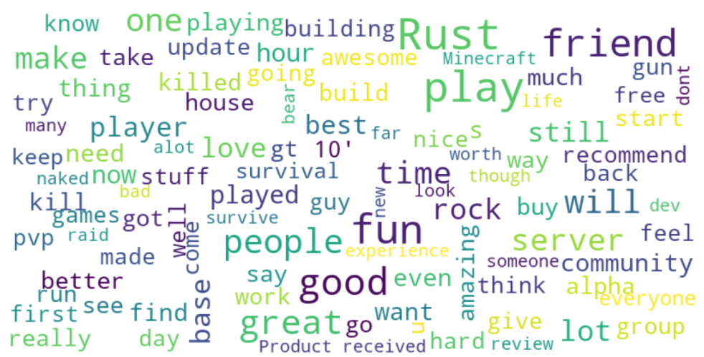
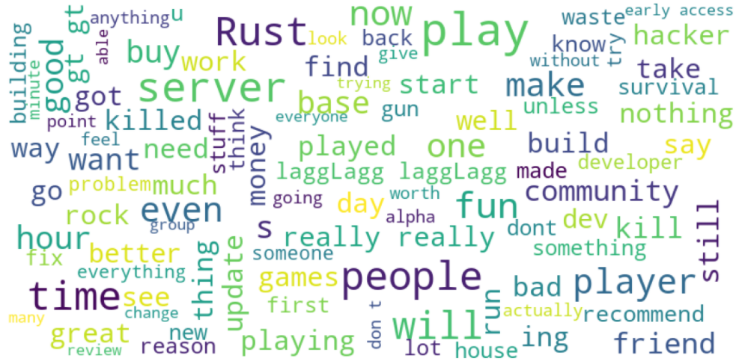
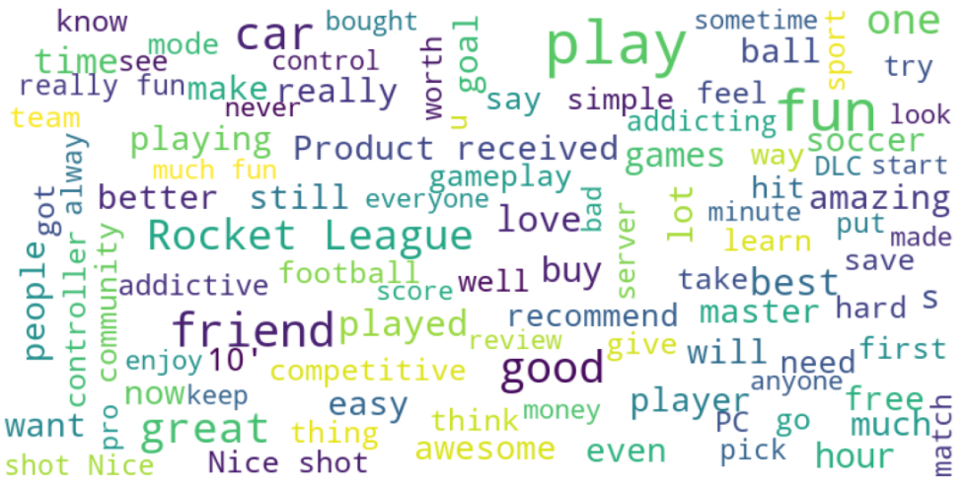
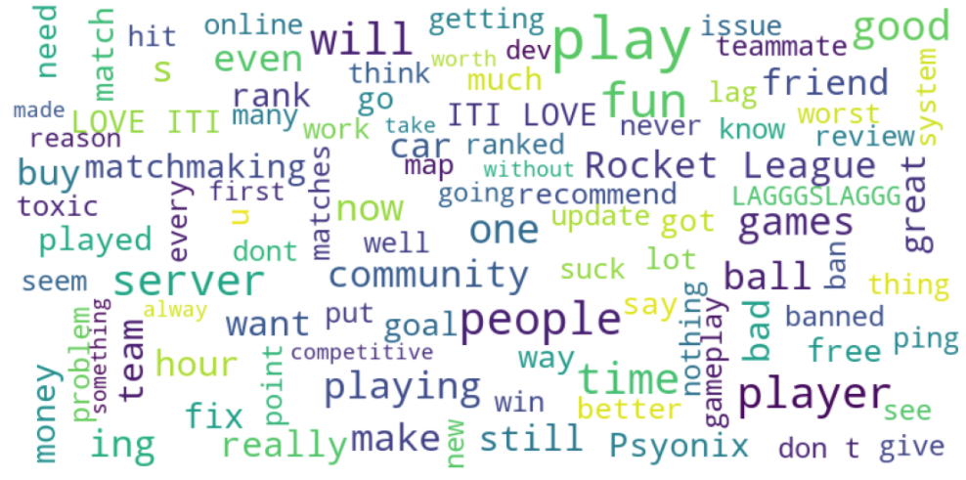
Key words for popular games
Game | Keywords |  | Analysis
 | Recommendation | Not Recommended
PUBG |  |  | Players enjoy the game with many positive reviews and compare it to H1Z1, a similar game. Players complain about the server, lag, and hacking.
Grand Theft Auto V |  |  | Players enjoy the open world and graphics. Players complain about hackers, modding, and being banned.
Rust |  |  | Players enjoy this survival aspect of the game. Players experience server and game crashing issues.
Rocket League |  |  | Players appear to love this game and use more positive words than normal like ‘best’, and ‘awesome.’ Players complain about the server/matchmaking and toxic players/behavior.
The top issue for the most popular games on Steam is online activity. These can range from cheating, bad matchmaking, game crashes and so on.

Slide 7
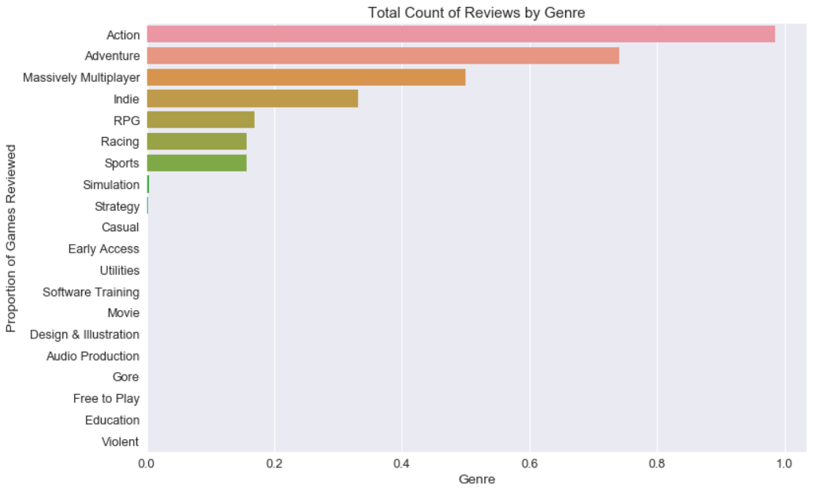
Genres
Steam reviewers are mainly interested in mainly playing Adventure, Massively Multiplayer, Indie , RPG, Racing, and Sports games.
Each of these genres account for over 15% of all Steam reviews.
Action is not helpful for analysis as most games are labeled as Action games.

Slide 8
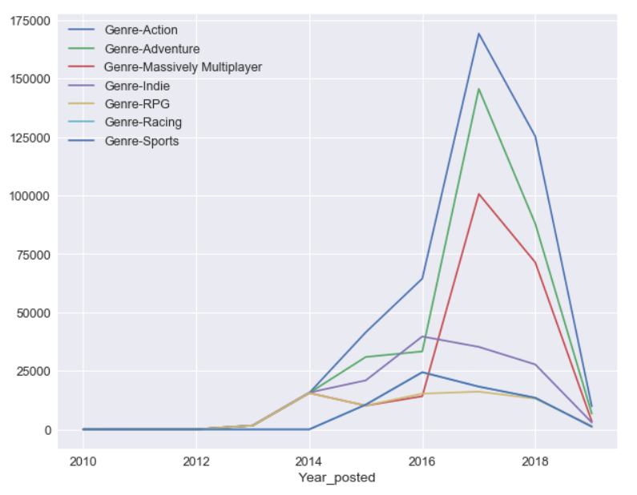
Genres
By 2017, Massively-Multiplayer, Action, and Adventure games saw a large increase wile Indie, RPG, Sports, and Racing games remained stagnant.
Steam should continue to focus on having Massively-Multiplayer, Adventure, and Action games, since these genres are what players are mainly interested in reviewing.

Slide 9
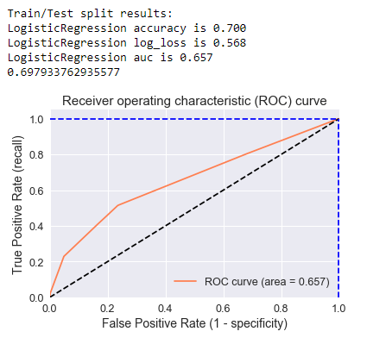
How successful is the data models
After testing the logistic regression, we can conclude that the data model is 70% accurate for incoming data.

Slide 10
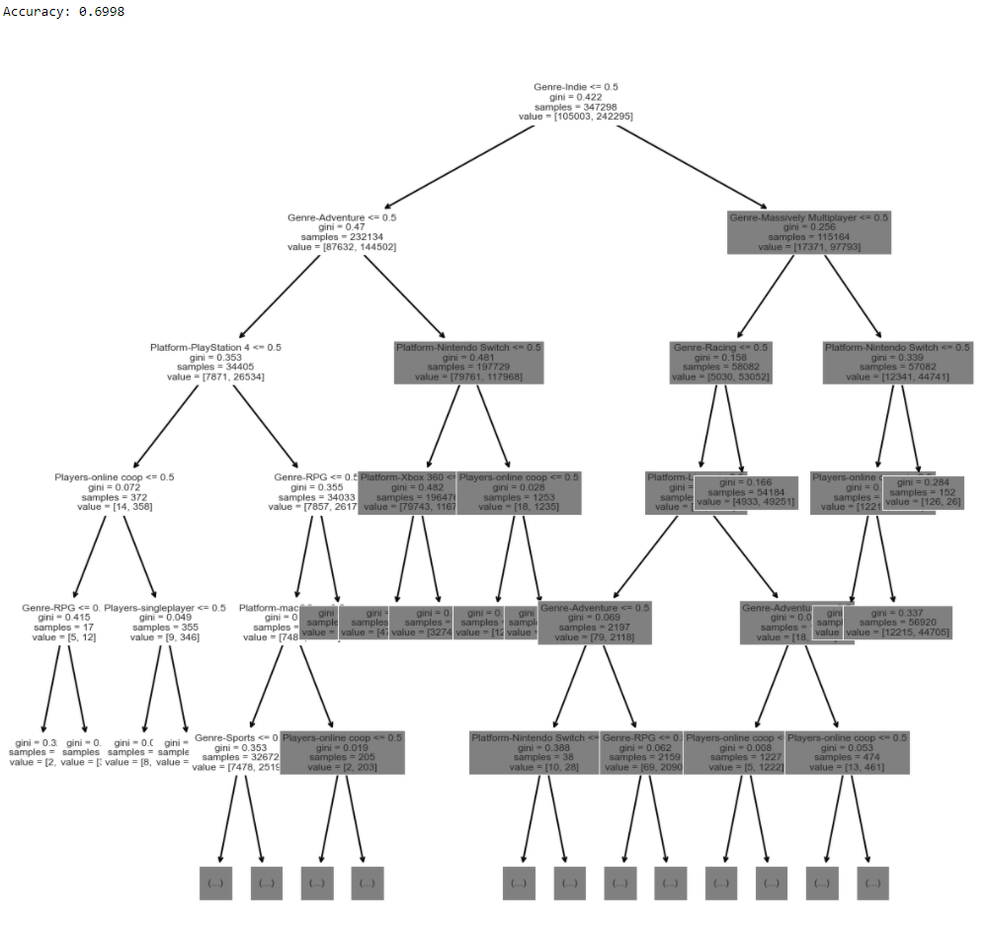
How successful is the data models
After testing through the decision tree classification, we can conclude that the data model is 70% accurate for incoming data.

Slide 11
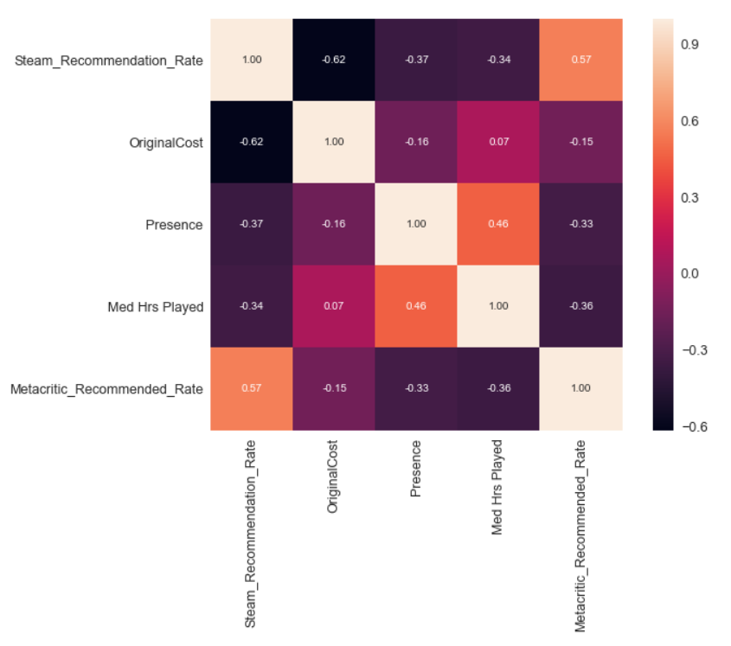
Attributes correlated with steam Recommendation Rate
According to the correlation matrix, Original cost and Metacritic user scores have a strong correlation with Steam Recommendation Rates with r values over 0.50.

Slide 12
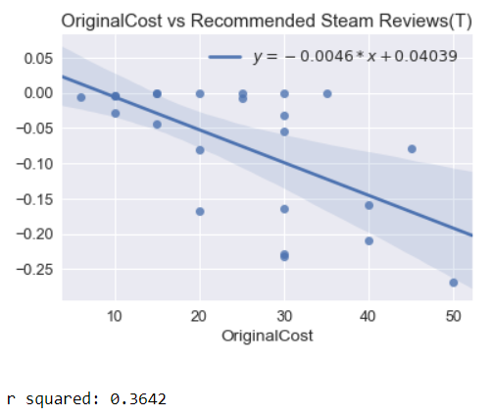
Game Original Cost
On Steam, we do see a negative correlation between the price of games and the Steam Recommendation Rate.
The optimal price range is $10-20. Games in these range tend to have a much higher recommendation rate.

Slide 13
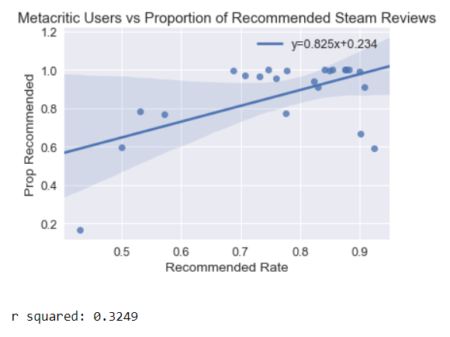
Metacritic User Score
On Steam, we do see a positive correlation between the Metacritic user scores and the Steam Recommendation Rate.
We can compare games with higher Metacritic user scores and project how they Steam reviewers will perceive the game.

Slide 14
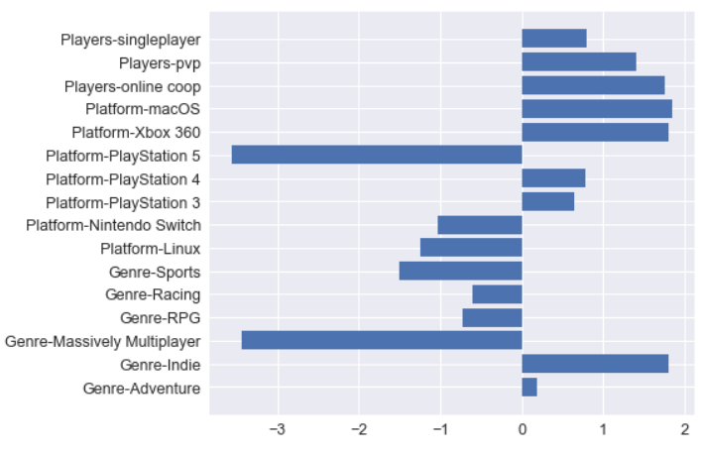
Feature importance
Indie, coop, pvp, gameplay tpyes and games available on CBOX360 as well as maxOS are more likely to be recommended.
Games that are also for the Playstaion 5 and Massive Multiplayer are less likely to be recommended.

Slide 15
Key conclusions
The most popular games on Steam have online functionality and can use some improvements. Steam can take this review directly to developers for product development.
Massively-Multiplayer, Adventure, Indie, and Action Genres have the highest total number of reviews.
Game Original Prices and Metacritic User Scores are the best indicators for Steam Recommendation Rates.
Massively-Multiplayer are less likely to be recommended to other players.

Slide 16
Appendix

Slide 17
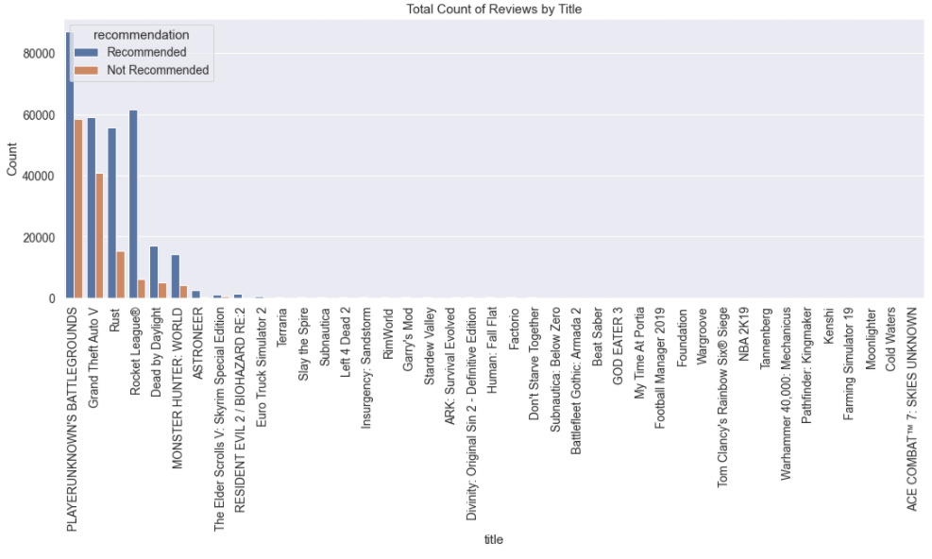
I. All Steam Reviews Sorted by Popularity

Slide 18
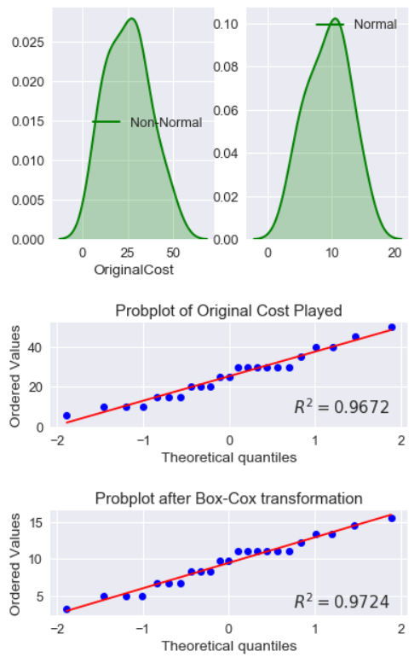
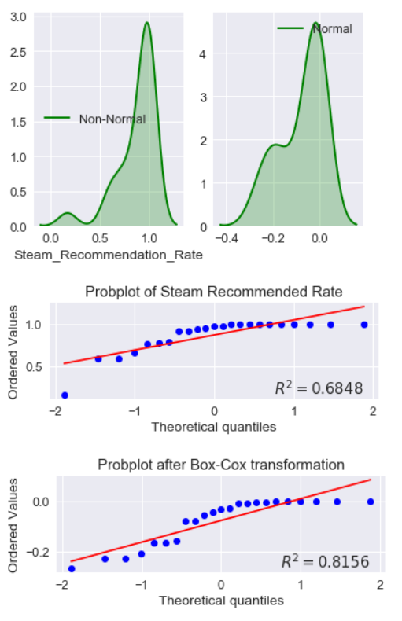
II. Probability Plots of Important Attributes
Original Cost
Steam Recommendation Rate
Original Cost follows a normal distribution.
Steam recommendation Rate is skewed to the left, so regression analysis uses the box cox transformed values.

Slide 19
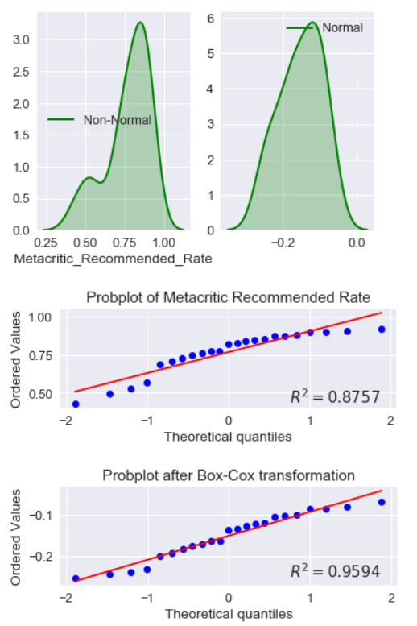
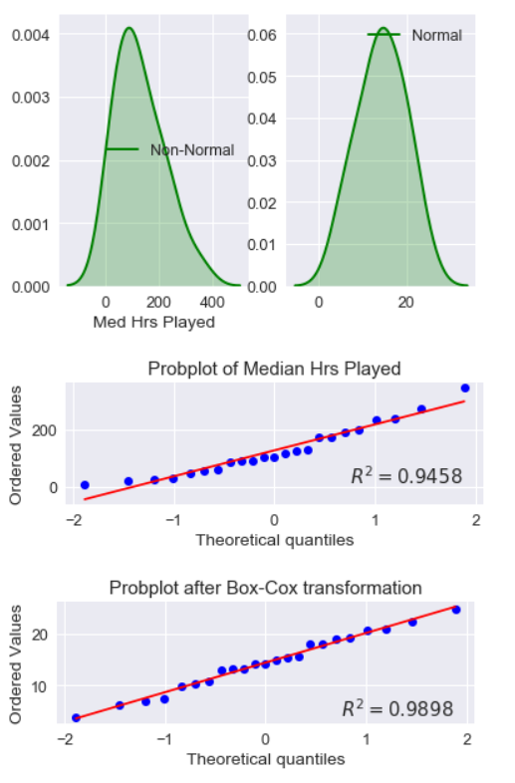
II. Probability Plots of Important Attributes
Metacritic Recommendation Rate
Median Hrs Played
Metacritic Recommendation Rate follows a normal distribution.
Median Hrs Played follows a normal distribution.

Slide 20
III. References
https://comparecamp.com/steam-statistics/#:~:text=Steam%20is%20the%20world's%20largest,year%20ever%20since%20its%20inception

